Slide 1
Neural Architectures:
Transformers
Introduction to Deep Learning: Class 5.4

Slide 2
Transformers: Main idea
How do I represent a sentence as a fixed length embedding?
Could take avg/max of each embedding dimension across tokens..
But this gives equal weight to each token.. When the importance of each token depends on the question you are trying to answer
Eg., “The food was great but the service was terrible”
Question: How was the food? Need to understand attribute “great” is bound to food
Question: How was the service? Need to understand attribute “terrible” is bound to service
A flat embedding representation that collapses the token embeddings into a single embedding vector would fail at this task

Slide 3
Sentiment classification based on sentence embeddings
Groundtruth
Loss
A classifier based average embedding can do no better than 75%!
Because it can never do better than 50% on sentences where food and service sentiments disagree
We need contextualized embeddings that are aware of token bindings.. i.e., bad refers to service, great refers to food..
Label
Fully Connected Layer
Classifier
Averaged embedding
Average token embeddings to produce a sentence embedding
e1 | e2 | e3 | e4 | e5 | e6 | e7 | e8 | e_pad | e_pad | e_pad | e_pad
Trainable embeddings
1 | 1 | 1 | 1 | 1 | 1 | 1 | 1 | 0 | 0 | 0 | 0
Attention mask
t1 | t2 | t3 | t4 | t5 | t6 | t7 | t8 | pad | pad | pad | pad
Tokenization
food food was great but service was bad

Slide 4
Attention
Query is the token for which we are trying to determine relevant tokens. Query is the token for which we are trying to define “what should this token look at, in the current context?”
Eg: “food was great but the service was terrible”
For query = sentiment, tokens great and terrible should be important
Query can come from another sentence, eg., in the context of language translation, or from the same sentence--”which tokens do I care about”?
Attention: Given a query q, which tokens in the sequence are relevant, and what information should we extract from them?

Slide 5
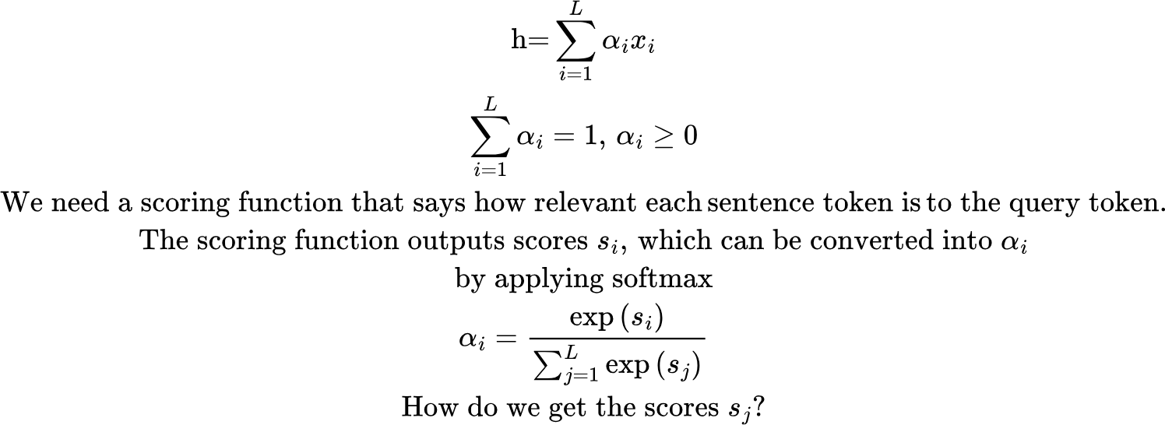
Attention
Importance scores: coefficients alpha that reflect the importance of each token to the query token.

Slide 6
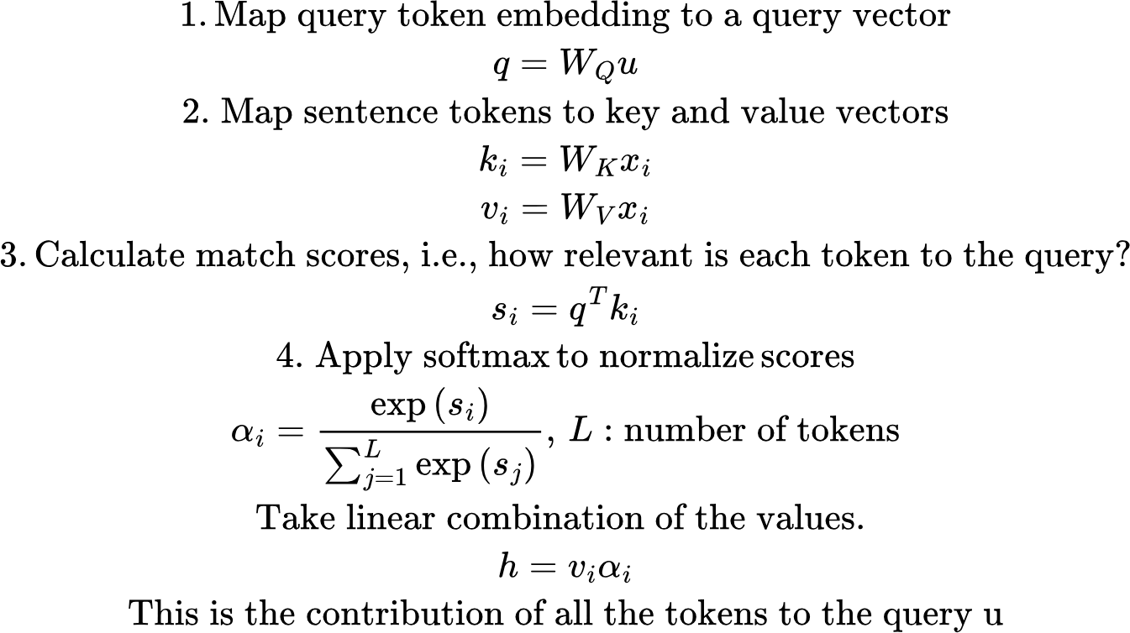
Attention
Rather than using pure embeddings we need to learn mappings Wq, Wk, Wv to:
Form queries (what to look for)
Form keys (how to match, advertise relevance)
Form values (what information to extract from those tokens)

Slide 7
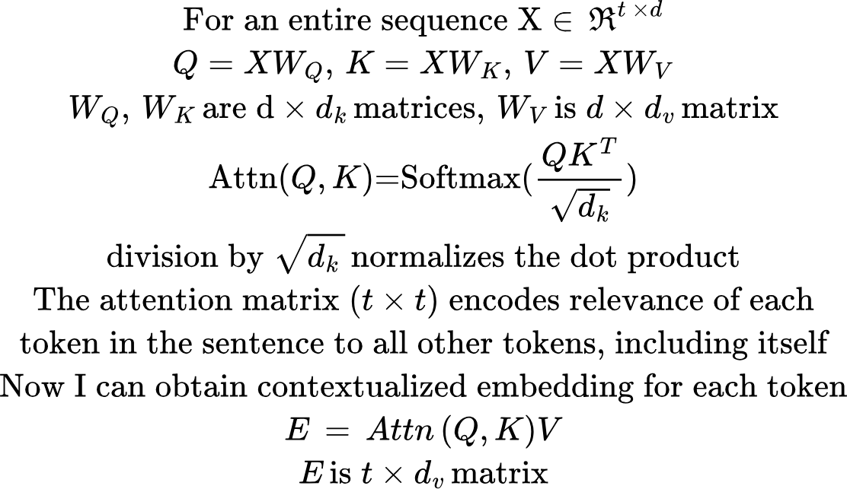
Self-Attention

Slide 8
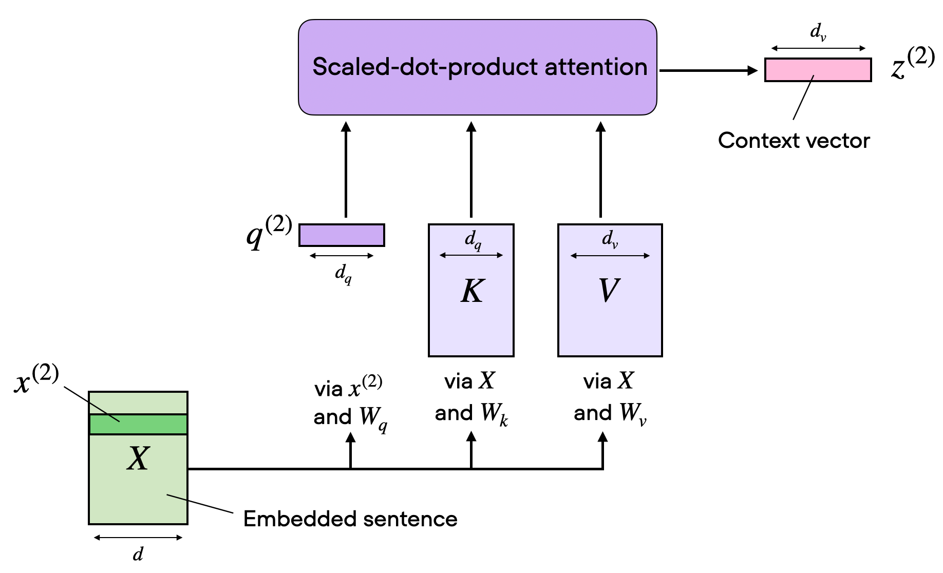
Self Attention

Slide 9
Encoding position
The attention mechanism by itself has no way of knowing where a token appears in a sentence.. It treats all tokens the same, regardless of position.
But position matters!
Eg., “The food was great but the service was terrible”
Question: How was the food? Need to understand attribute “great” is bound to food
Here “great” is associated with food because it appears near food. If I swapped “terrible” and “great”, then “great” becomes associated with service
So, we need to add a position embedding. These can be:
Learnable (as in our example)
Absolute position embeddings
Relative position embeddings (ROPE: the standard now)

Slide 10
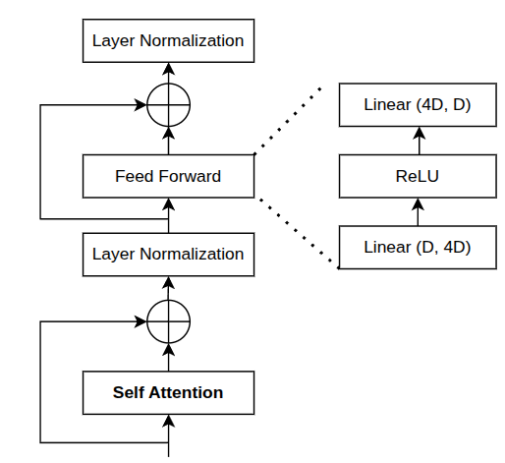
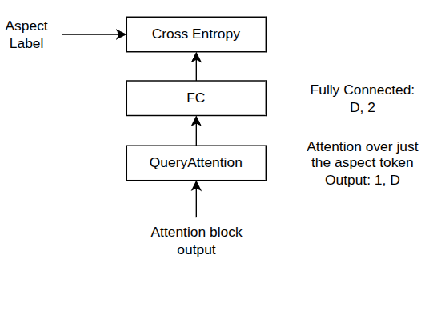
Sentiment classification using Attention
Attention Block
Outputs contextualized embeddings
Feed Forward: Mixes info across embedding (channel) dimension
Skip Connection: Stable optimization, don’t destroy previous representation
LayerNorm: Keeps activations well-scaled, learning stable
1, T, D
e1+p1 | e2+p2 | e3+p3 | e4+p4 | e5+p5 | e6+p6 | e7+p7 | e8+p8 | e_pad+p9 | e_pad+p10 | e_pad+p11 | e_pad+p12
Trainable token + position embeddings
1 | 1 | 1 | 1 | 1 | 1 | 1 | 1 | 0 | 0 | 0 | 0
Attention mask
t1 | t2 | t3 | t4 | t5 | t6 | t7 | t8 | pad | pad | pad | pad
Tokenization
food food was great but service was bad

Slide 11
Attention masking
Sentences in a batch can be of different lengths. Accounting for varying sentence lengths would preclude batch matrix multiplications.. To address this, sentences in a batch are filled with padding tokens to make them the same length. But, we don’t want the padding tokens to contribute to the attention scores..

Slide 12
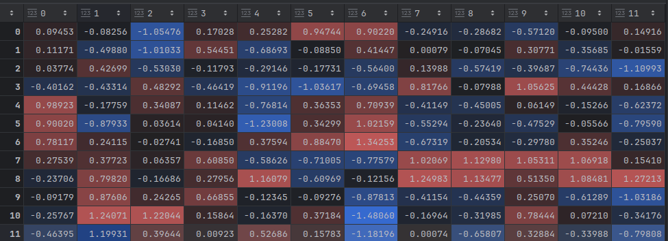
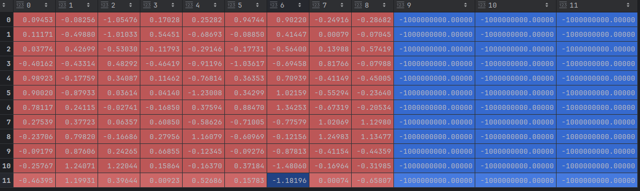
Attention masking
food | food | was | great | but | the | service | was | bad | pad | pad
Each row is attention values for the row token. We want to ignore the contribution of the pad tokens in the softmax. We do this by adding a large negative number for the padding tokens. This puts negative probability on those tokens after softmax
But why not ignore the padding tokens rows too?
food
food
was
bad
but
the
service
was
bad
pad
pad
pad

Slide 13
Attention masking
Why don’t we remove rows for pad tokens? That’s just wasted computation!
Rows correspond to queries: “what does token i attend to?”
Padding tokens don’t matter, but deleting rows would change shapes per example (ragged tensors), which breaks vectorized kernels, simple batching on GPUs..
After attention, the FFN is applied independently to each token position:
FFN(X)[i] = MLP(X[i])
So FFN (and residual connections) does not mix tokens, only features. That means if padding token representations become garbage, they won’t contaminate real tokens through the FFN.
The only place tokens mix is attention, and there we use the “add a large negative number” trick to remove pad tokens

Slide 14
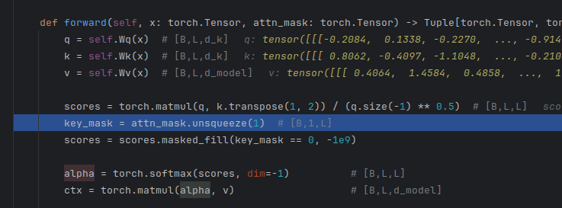
Broadcasting
Scores: B, L, L
Attention mask: B, L
To apply attention mask to all rows of scores, we add a singleton dimension, and then broadcast across all dimensions

Slide 15
Self-Attention + Query Attention classifier: Results
Classification accuracy on test data for a few epochs
epoch 08 | mean: loss=0.3511 acc=0.768 | attn+ctx: loss=0.0000 acc=1.000
epoch 09 | mean: loss=0.3507 acc=0.744 | attn+ctx: loss=0.0000 acc=1.000
epoch 10 | mean: loss=0.3503 acc=0.744 | attn+ctx: loss=0.0000 acc=1.000
Inference Example:
query_aspect: food label: 0
tokens: the food was bad the service was good
encoder self-attn ('good' token attends to...):
food:0.00 the:0.02 food:0.01 was:0.16 bad:0.07 the:0.02 service:0.02 was:0.26 good:0.44
encoder self-attn ('bad' token attends to...):
food:0.91 the:0.01 food:0.06 was:0.00 bad:0.00 the:0.01 service:0.00 was:0.00 good:0.00
pooling attn (where we read out from):
food:0.00 the:0.00 food:0.00 was:0.00 bad:0.99 the:0.00 service:0.00 was:0.00 good:0.00
attention_binding_demo_v2.py

Slide 16
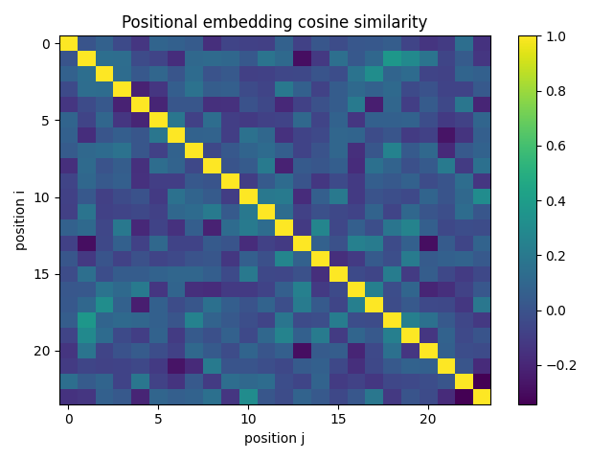

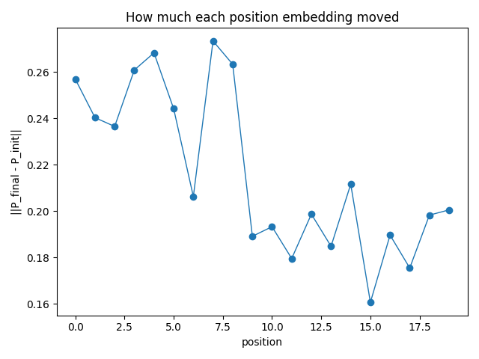
Learnt Position Embeddings
No visible change in the position embedding dot product heatmap, but the embeddings did change, with the movement higher for non-pad tokens..
The network learns just enough to do its job! No learning signal once accuracy reaches 100%..

Slide 17
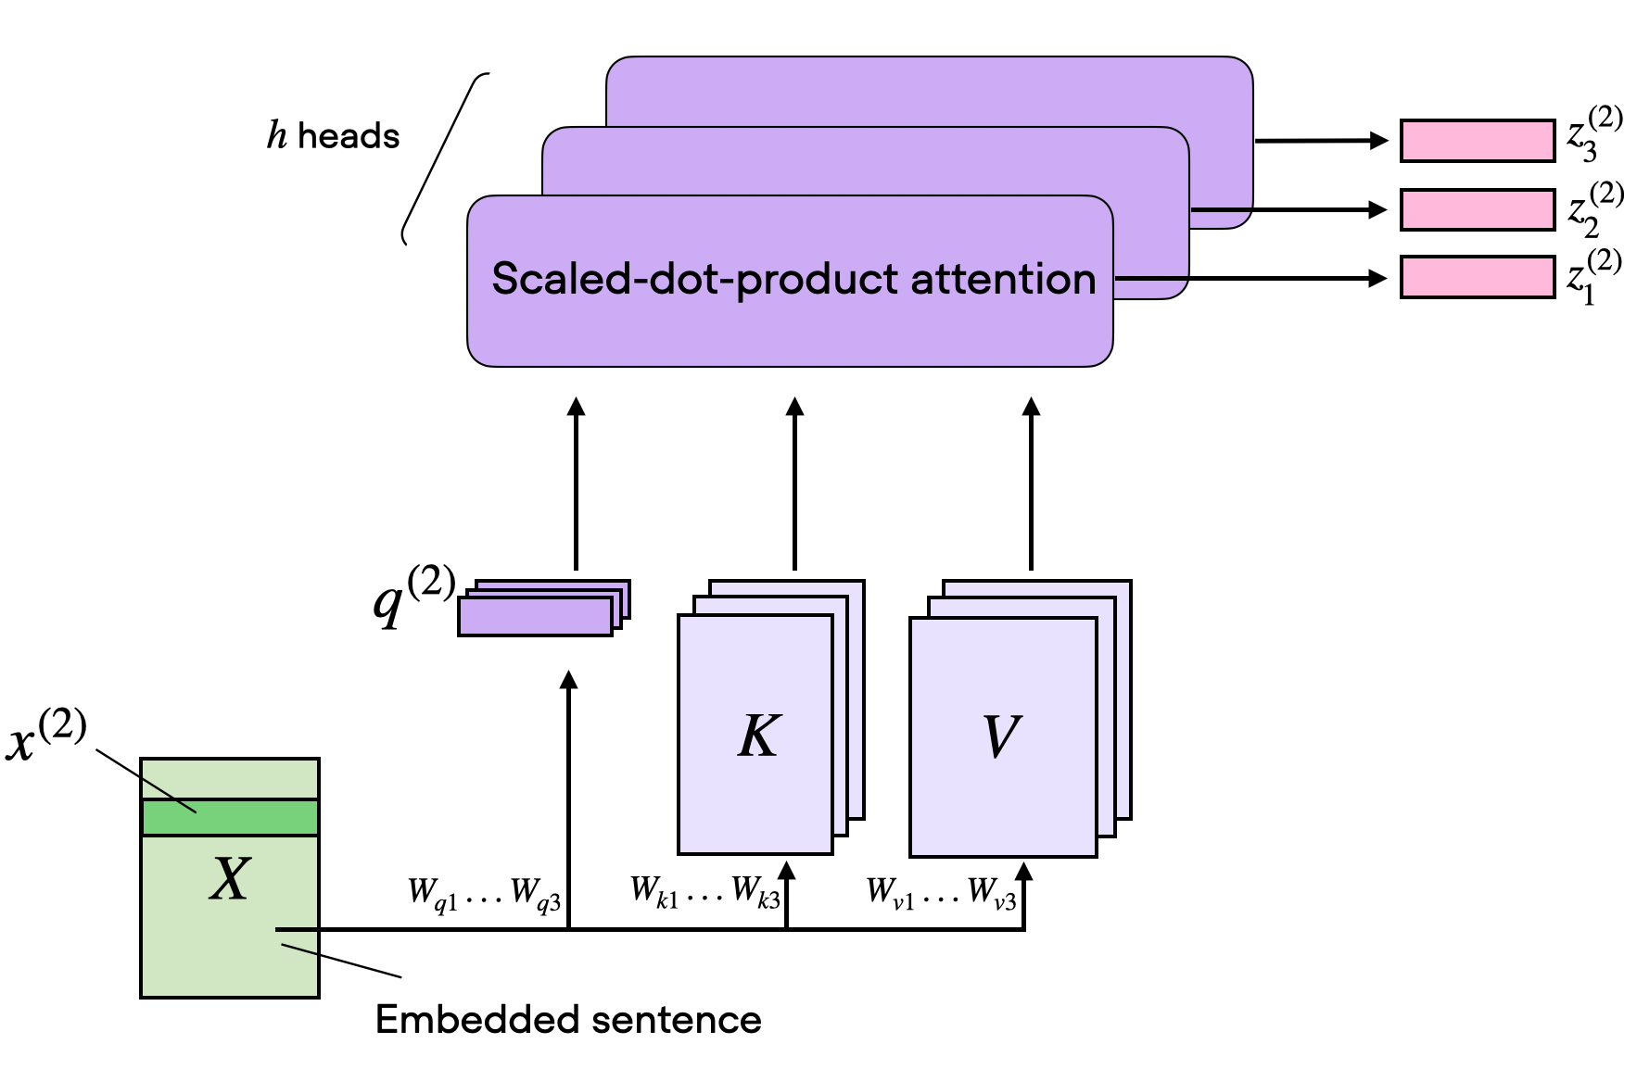
Multi-headed Attention
Instead of one single attention mechanism, Multi-Headed Attention (MHA) uses multiple parallel "heads" to independently compute attention scores, allowing the model to capture diverse, nuanced, and parallel relationships.

Slide 18
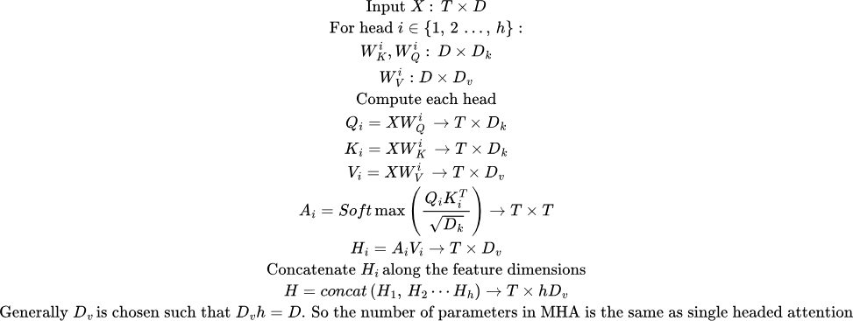
Multi-headed Attention

Slide 19
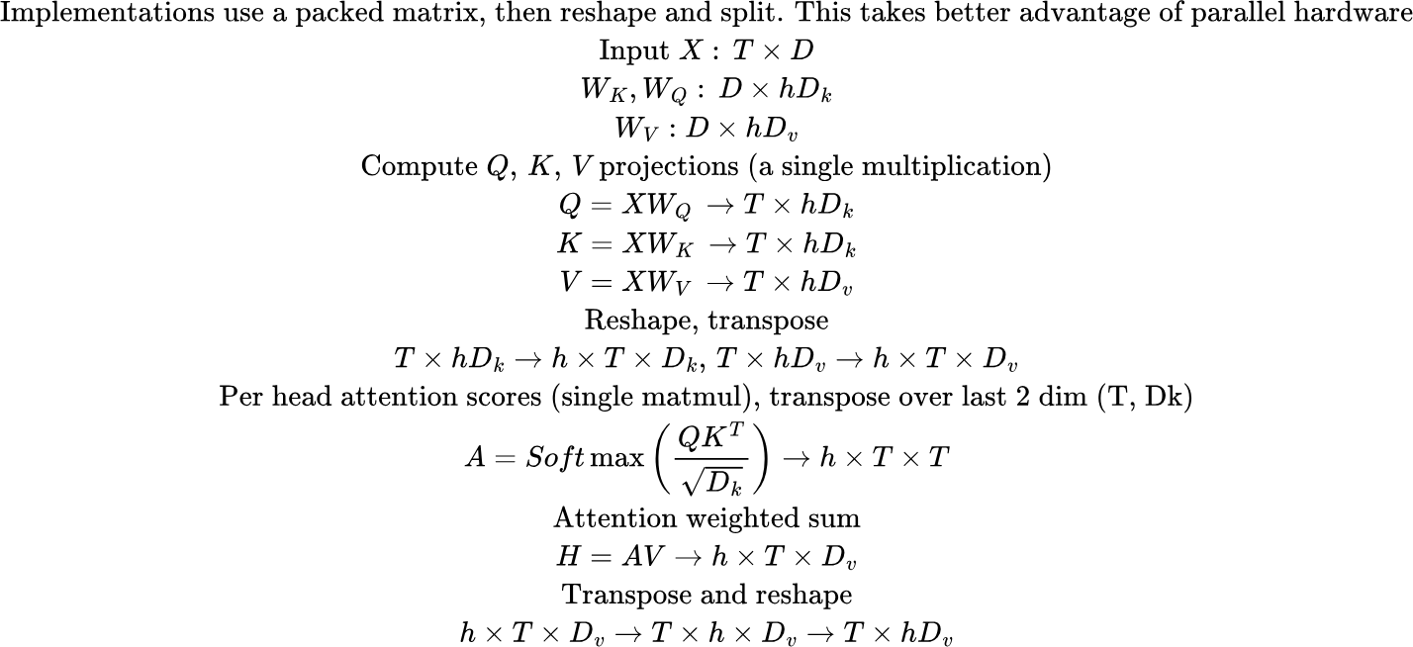
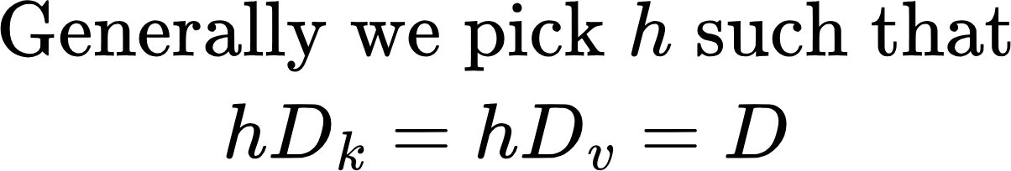
Multi-headed Attention
Ignoring the batch dimension here..
Attention mask: (1,T)
We’ll broadcast over h, T dimensions

Slide 20
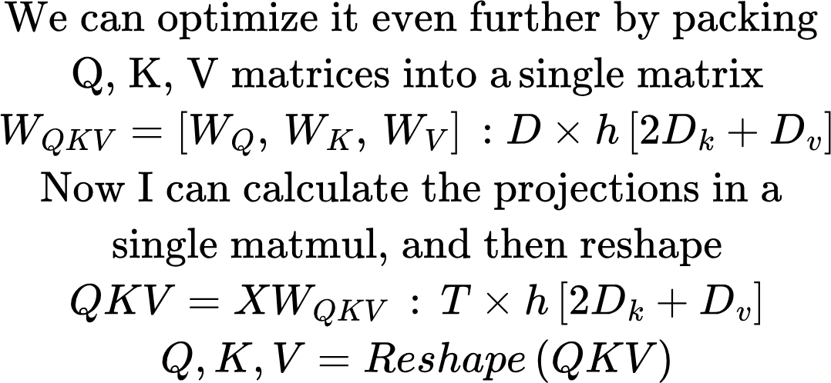
Multi-headed Attention
B, T, h, D = 64, 256, 8, 512, RTX 5090 GPU
--- Projection-only timing ---
non-packed (3*h matmuls) 0.5564 ms/iter (200 iters)
packed (3 matmuls) 0.2254 ms/iter (200 iters)
packed (1 matmul) 0.2111 ms/iter (200 iters)
--- Full attention timing ---
full: non-packed proj 1.0561 ms/iter (200 iters)
full: packed QKV proj 0.7035 ms/iter (200 iters)
B, T, h, D = 64, 512, 8, 512, RTX 5090 GPU
--- Projection-only timing ---
non-packed (3*h matmuls) 1.3381 ms/iter (200 iters)
packed (3 matmuls) 0.5558 ms/iter (200 iters)
packed (1 matmul) 0.4643 ms/iter (200 iters)
--- Full attention timing ---
full: non-packed proj 3.3791 ms/iter (200 iters)
full: packed QKV proj 2.5052 ms/iter (200 iters)
Because attention calculation is O(T^2), it starts to dominate as sequence length increases.. Projection calculation is O(T)..
packed_vs_nonpacked_timing.py

Slide 21
What’s next..
Token encodings
Position encodings
Transformer-based architectures

